Slide 1
Classes and Modules
Pravinkumar Dabade

Slide 2
Agenda
Introduction to Class syntax
Class as expression
Writing properties and methods
Inheritance
Static methods
Introduction to ECMA2015 Modules
Creating Modules
Loading modules and its dependencies

Slide 3
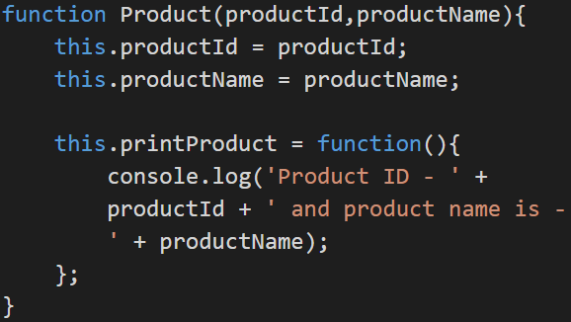
Introduction to Class syntax
In ES5, you can mimic the class definition using a function
For example –

Slide 4
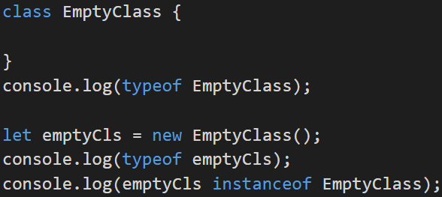
Introduction to Class syntax
In ECMA2015, we can write class using a class keyword –
For example –

Slide 5
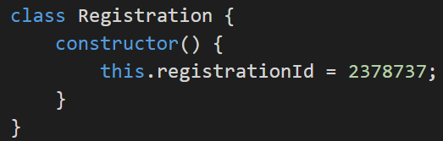
Introduction to Class syntax
Writing properties in class –
For example –

Slide 6
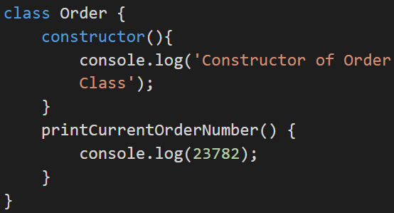
Introduction to Class syntax
Writing methods in class –
For example –

